Slide 1
The Lemonade War Spelling and Vocabulary Words
Chapters 13-14

Slide 2
Spelling Words
leadership
gracefully
refreshment
uncomfortable
overdoing
remarkable
carefully
unbearably
ownership
unacceptable
impossibly
reappeared
unprepared
oncoming
misbehaving
outrageous
incomprehensible
undoubtedly
independence
disadvantage

Slide 3
Vocabulary Words
reprimand
even
uneven
shriek
pulverize
solemnly

Slide 4
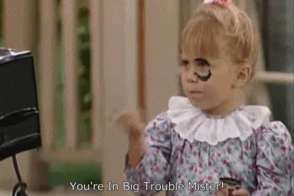
reprimand
Punish

Slide 5
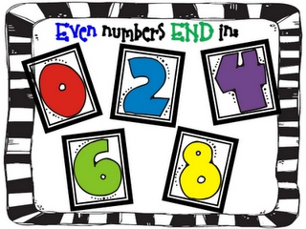
even
A number divisible by 2

Slide 6
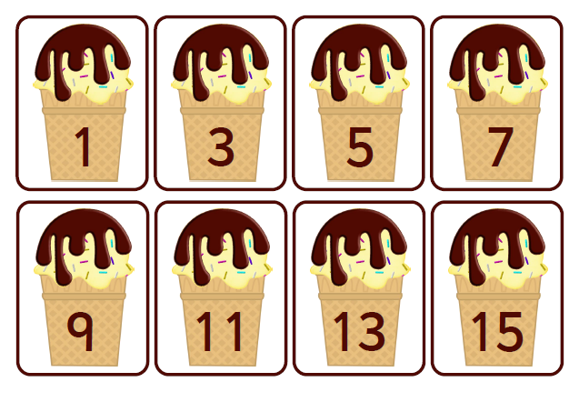
uneven
A number not divisible by 2

Slide 7
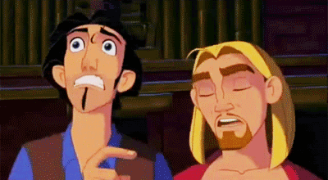
shriek
Yell loudly

Slide 8
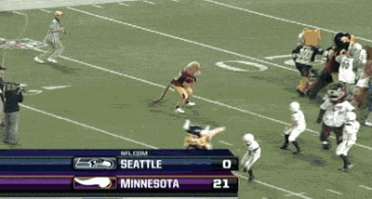
pulverize
To conquer, win

Slide 9
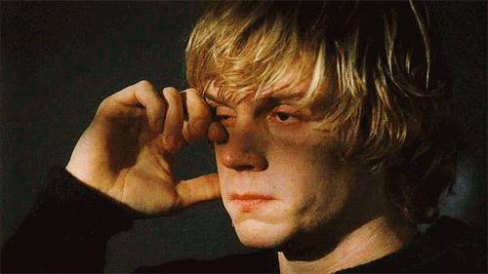
solemnly
Quietly with regret

